Slide 1
HTML Forms
WEB DEVELOPMENT · LESSON
Building a Sign-Up Page, One Line at a Time
A complete beginner's walkthrough of every tag and every attribute in a working sign-up form.
<form>
<label>
<input>
<input>
<submit>
</form>
BY THE END OF THIS LESSON
Learning objectives
1 | What an HTML form is, and why every website needs one
2 | The three building blocks: <form>, <label> and <input>
3 | What every single attribute in the code does
4 | Answer exam-style questions on form, writing and interpreting code by hand
1

Slide 2
HTML Forms
OUR PROJECT
Signup.html This is what we are building
Sign up
Username:
Password:
Sign up
A sign-up form as the visitor sees it in the browser.
A heading | The words 'Sign Up' at the top.
Two labels | The words 'Username:' and 'Password:'.
Two boxes | The empty rectangles where the visitor types.
One button | The small 'Sign up' button that sends everything.
2

Slide 3
HTML Forms
OUR PROJECT
The full HTML – signup.html
1 | <!DOCTYPE html>
2 | <html lang="en">
3 | <head>
4 | <meta charset="UTF-8">
5 | <meta name="viewport" content="width=device-width, initial-scale=1.0">
6 | <title>Sign Up</title>
7 | </head>
8 | <body>
9 | <h1>Sign Up</h1>
10 | <form action="signup.php" method="post">
11 | <label for="user">Username:</label>
12 | <input type="text" id="user" name="user">
13 | <br><br>
14 | <label for="pw">Password:</label>
15 | <input type="password" id="pw" name="pw">
16 | <br><br>
17 | <input type="submit" value="Sign up">
18 | </form>
19 | </body>
20 | </html>
3

Slide 4
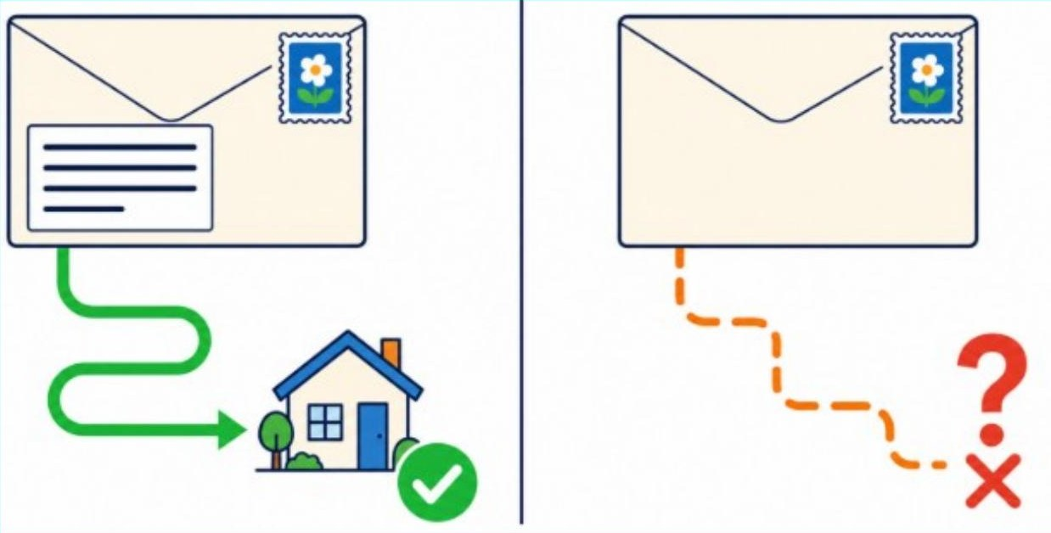
HTML Forms
LINE 1 · ATTRIBUTE 1 OF 2
action="signup.php" — where the data is sent
action is the destination address of the filled-in form.
1 | <form action="signup.php" method="post">
2 | <label for="user">Username:</label>
3 | <input type="text" id="user" name="user">
4 | <label for="pw">Password:</label>
5 | <input type="password" id="pw" name="pw">
6 | <input type="submit" value="Sign up">
7 | </form>
LINE 1 OF 7 · FIRST ATTRIBUTE
When the visitor clicks the button, the browser needs to know where to deliver what was typed. The action attribute answers that question by naming a file: signup.php.
That file sits on the web server. Inside it is code that receives the username and password, checks them, and saves the new account into a database.
Change this file name and the data goes somewhere else.
THINK OF IT LIKE THIS
The address written on the front of an envelope. A letter with no address never arrives anywhere.
4

Slide 5
HTML Forms
LINE 1 · ATTRIBUTE 2 OF 2
method="post" — how the data travels
method chooses the way the typed values are carried to the server.
1 | <form action="signup.php" method="post">
2 | <label for="user">Username:</label>
3 | <input type="text" id="user" name="user">
4 | <label for="pw">Password:</label>
5 | <input type="password" id="pw" name="pw">
6 | <input type="submit" value="Sign up">
7 | </form>
LINE 1 OF 7 · SECOND ATTRIBUTE
There are two choices. post tucks the values quietly inside the body of the request, where they are not displayed on screen. get instead pastes them onto the end of the web address in the address bar.
Because this form carries a password, post is the correct and safe choice here.
Passwords must always travel by post, never by get.
5

Slide 6
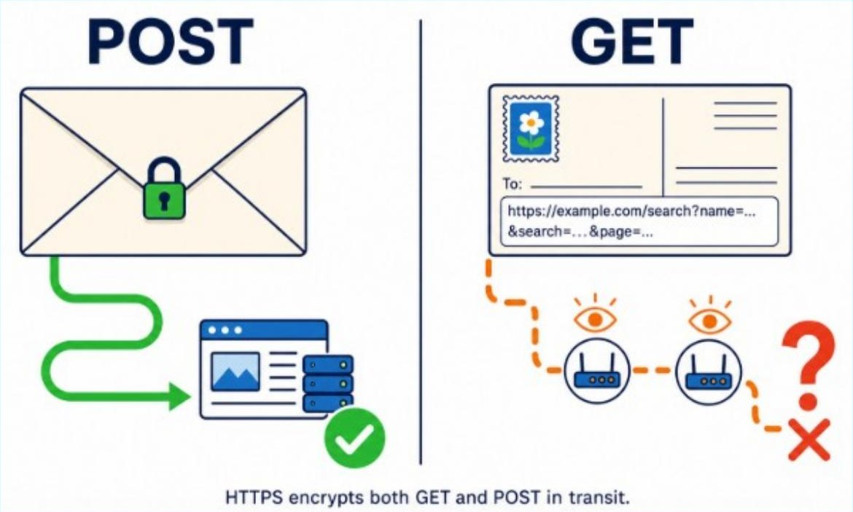
HTML Forms
THINK OF IT LIKE THIS
post is a sealed envelope. get is a postcard — anyone who handles it can read it on the way.
LINE 1 · GOING DEEPER
post and get, side by side
method="post" | method="get"
Use this for sign-up, log in, payments | Use this for searches and filters
• Values are hidden inside the request • The address bar stays clean • Can carry large amounts of data • Safe for passwords and private details • Cannot be bookmarked or shared | • Values are pasted into the web address • Everything is visible in the address bar • Limited to a small amount of data • Never use it for passwords • Can be bookmarked and shared
Rule of thumb: if the data is private or changes something on the server, use post.
6

Slide 7

HTML Forms
The visible words sit between the two tags.
THINK OF IT LIKE THIS
post is a sealed envelope. get is a postcard — anyone who handles it can read it on the way.
LINE 2 · GOING DEEPER
Three reasons labels are not optional
1 Clarity | 2 A bigger click target | 3 Screen readers
An empty box on its own means nothing. The label tells the visitor exactly what belongs in it. | Because for="user" links them, clicking the word Username: places the cursor into the box. That is a real help on a phone. | Visually impaired users hear the page read aloud. A linked label is read out with the box; an unlinked box is announced as an unnamed edit field.
Accessibility is not an extra feature.
It is part of writing correct HTML.
7

Slide 8
HTML Forms
LINE 3 · THE FIRST INPUT
<input> — the box the visitor types into
One <input> tag draws one box on the screen.
1 | <form action="signup.php" method="post">
2 | <label for="user">Username:</label>
3 | <input type="text" id="user" name="user">
4 | <label for="pw">Password:</label>
5 | <input type="password" id="pw" name="pw">
6 | <input type="submit" value="Sign up">
7 | </form>
LINE 3 OF 7
Notice something unusual: there is no </input> anywhere. <input> is a self-closing tag, because it has no content to wrap around. It simply is the box. This is a void element.
Three attributes are packed inside this one line, and each does a completely different job.
8

Slide 9
HTML Forms
TASK 1
Quick Quiz
Ten questions on the first three lines of your sign-up form
Write A, B, C or D for each question.
THE LINES UNDER TEST
1 | <form action="signup.php" method="post">
2 | <label for="user">Username:</label>
3 | <input type="text" id="user" name="user">
SET 1 OF 2 · QUESTIONS
Questions 1 to 5
1. Which tag creates the container that holds the whole form together?
A | <container>
B | <form>
C | <input>
D | <label>
Answer: ____________________________
9

Slide 10
HTML Forms
2. In line 1, what is the job of action="signup.php"?
A | It sets the colour of the button
B | It names the file that will receive the data
C | It decides what the visitor may type
D | It closes the form
Answer: ____________________________
3. Why does this form use method="post" rather than method="get"?
A | post is faster than get
B | post keeps the typed values out of the address bar
C | post is the only method PHP understands
D | post makes the boxes wider
Answer: ____________________________
4. In <label for="user">Username:</label>, which part does the visitor actually see on screen?
A | for="user"
B | Username:
C | The word label
D | Every character in the line
Answer: ____________________________
10

Slide 11
5. The for="user" written on the label must match which attribute on the input?
A | name
B | type
C | id
D | value
Answer: ____________________________
SET 2 OF 2 · QUESTIONS
Questions 6 to 10
6. How does the line <input type="text" id="user" name="user"> get closed?
A | With </input>
B | With </text>
C | It does not — <input> is self-closing
D | With a second <input>
Answer: ____________________________
7. What does type="text" tell the browser to do?
A | Make the writing bold
B | Draw a plain single-line box with visible characters
C | Send the text to the server
D | Print the word 'text' inside the box
Answer: ____________________________
11

Slide 12
8. Which attribute becomes the key the server uses to read what was typed?
A | id
B | name
C | type
D | for
Answer: ____________________________
9. A student deletes name="user" from line 3. What happens?
A | The box disappears from the page
B | The browser shows an error message
C | The box still works, but its value is never sent to the server
D | The page refuses to load
Answer: ____________________________
HTML Forms
10. A student writes <label for="username"> but leaves id="user" on the input. What breaks?
A | Nothing at all
B | The input box disappears
C | The label and box are no longer linked, so clicking the label does nothing
D | The data is sent to the wrong file
Answer: ____________________________
12

Slide 13
HTML Forms
LINE 4 · THE SECOND LABEL
<label for="pw">Password:</label>
Password:
Sign up
The pattern from line 2 simply repeats, with new words.
1 | <form action="signup.php" method="post">
2 | <label for="user">Username:</label>
3 | <input type="text" id="user" name="user">
4 | <label for="pw">Password:</label>
5 | <input type="password" id="pw" name="pw">
6 | <input type="submit" value="Sign up">
7 | </form>
LINE 4 OF 7
Nothing new is being introduced here. The visible text is now Password:, and the pointer is now for="pw", which will match the id of the box on the next line.
Same shape as line 2 — only the words changed.
13

Slide 14
HTML Forms
LINE 5 · THE PASSWORD BOX
type="password" — hiding what is typed
Password:
●●●●●●●●
Sign up
password draws the same box; it shows dots instead of characters.
1 | <form action="signup.php" method="post">
2 | <label for="user">Username:</label>
3 | <input type="text" id="user" name="user">
4 | <label for="pw">Password:</label>
5 | <input type="password" id="pw" name="pw">
6 | <input type="submit" value="Sign up">
7 | </form>
LINE 5 OF 7 · FIRST ATTRIBUTE
The visitor types normally and the real value is stored and sent normally. Only the display is masked, so that somebody standing behind the visitor cannot read the password off the screen.
14

Slide 15
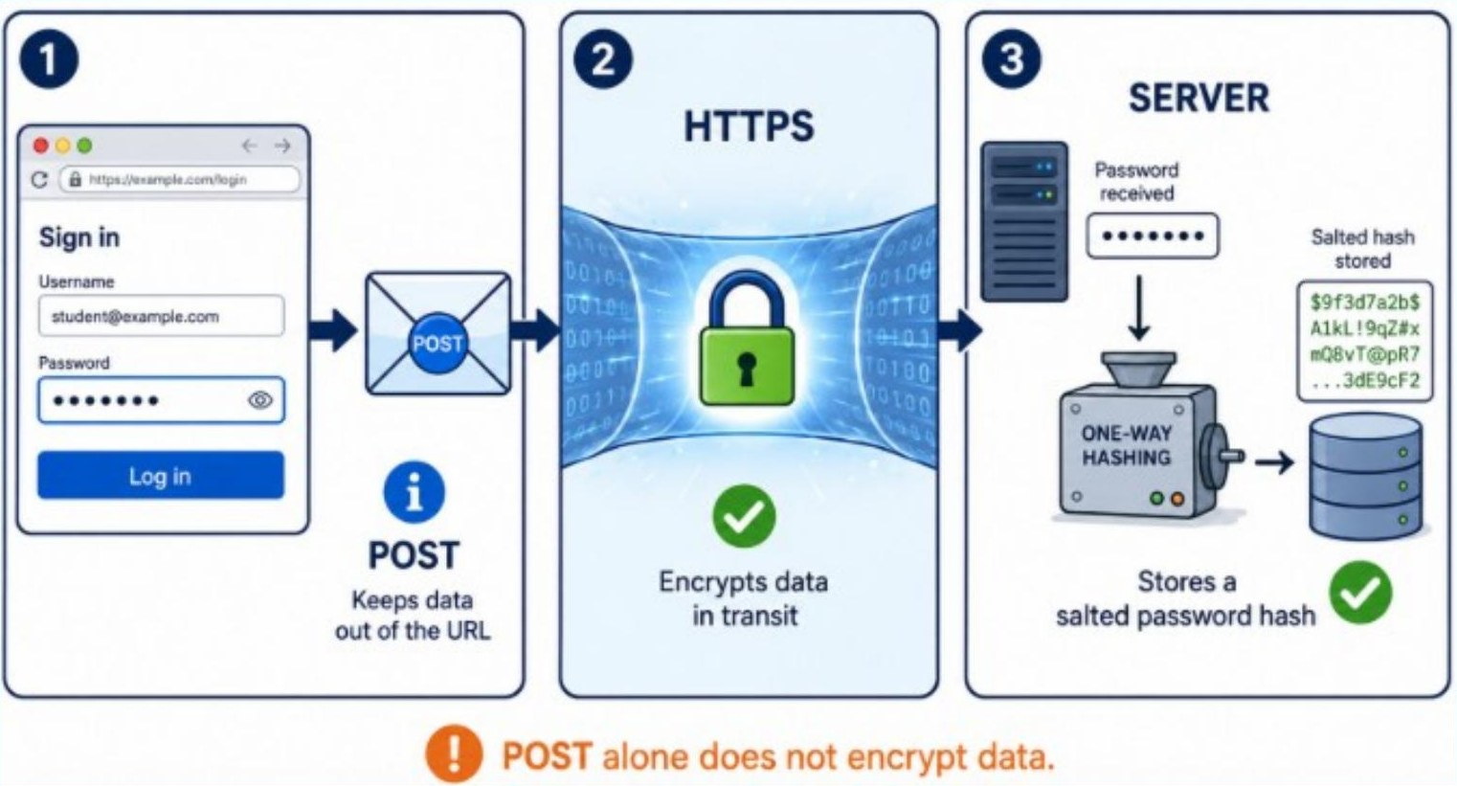
HTML Forms
Masking is a screen shield, not encryption.
LINE 5 · THE REMAINING ATTRIBUTES
id="pw" and name="pw" — the same two jobs
Every box needs its own unique id and its own name.
1 | <form action="signup.php" method="post">
2 | <label for="user">Username:</label>
3 | <input type="text" id="user" name="user">
4 | <label for="pw">Password:</label>
5 | <input type="password" id="pw" name="pw">
6 | <input type="submit" value="Sign up">
7 | </form>
LINE 5 OF 7 · SECOND AND THIRD ATTRIBUTES
15

Slide 16
HTML Forms
LINE 6 · THE BUTTON TEXT
value="Sign up" — the words printed on the button
On a submit button, value is simply the caption the visitor reads.
1 | <form action="signup.php" method="post">
2 | <label for="user">Username:</label>
3 | <input type="text" id="user" name="user">
4 | <label for="pw">Password:</label>
5 | <input type="password" id="pw" name="pw">
6 | <input type="submit" value="Sign up">
7 | </form>
LINE 6 OF 7 · SECOND ATTRIBUTE
Compare this with the screenshot: the small button says Sign up, and here in the code is exactly where those words come from.
One warning worth remembering. On a text box, value means something entirely different — there it fills the box with starting text before the visitor types anything.
16

Slide 17
HTML Forms
Change it to value="Register" and the button reads Register.
Register
LINE 6 · THE BUTTON TEXT
value="Sign up" — the words printed on the button
On a submit button, if there is no value, then the button just says Submit.
Submit
1 | <form action="signup.php" method="post">
2 | <label for="user">Username:</label>
3 | <input type="text" id="user" name="user">
4 | <label for="pw">Password:</label>
5 | <input type="password" id="pw" name="pw">
6 | <input type="submit" value="Sign up">
7 | </form>
LINE 6 OF 7 · SECOND ATTRIBUTE
17

Slide 18
HTML Forms
LINE 7 · THE CLOSING TAG
</form> — closing the container
Everything that must be sent has to sit above this line.
1 | <form action="signup.php" method="post">
2 | <label for="user">Username:</label>
3 | <input type="text" id="user" name="user">
4 | <label for="pw">Password:</label>
5 | <input type="password" id="pw" name="pw">
6 | <input type="submit" value="Sign up">
7 | </form>
LINE 7 OF 7
The slash in </form> tells the browser that the container opened on line 1 ends here. Boxes written after this line still appear on the page, but they are outside the form and are silently ignored when the button is clicked.
Forgetting this single line is one of the most common beginner errors, and it produces a form that looks perfect and does nothing.
The forward slash is what makes a tag a closing tag.
18

Slide 19
HTML Forms
PUTTING IT TOGETHER
What happens the moment you click Sign up
1 Collect | 2 Package | 3 Deliver | 4 Respond
The browser looks inside <form> and finds every box that has a name attribute. | Each box becomes a pair: user=ada and pw=secret123. | The package is sent to signup.php using the post method. | The server reads the values, saves the account, and sends back a new page.
All four steps happen automatically. You did not write a single line of JavaScript.
19

Slide 20
HTML Forms
GOING FURTHER
Change one word, get a different control
The code | What the browser draws | Typical use
type="text" | A plain single-line box | Names, cities, job titles
type="password" | Characters appear as dots | Passwords and PIN codes
type="email" | Checks that an @ is present | Email addresses
type="number" | Digits only, with up and down arrows | Age, quantity, price
type="date" | Opens a small calendar to pick from | Date of birth, booking dates
type="checkbox" | A tick box; several may be ticked | Interests, terms and conditions
type="radio" | Round buttons; only one may be chosen | Gender, delivery option
type="submit" | A clickable button that sends the form | Sign up, Log in, Search
Everything else in the line — id, name and the closing bracket — stays exactly the same.
20

Slide 21
HTML Forms
TROUBLESHOOTING
Four mistakes almost every beginner makes
! Forgetting name | ! Forgetting </form>
The box appears and accepts typing, but the server receives nothing at all. Always ask: does every input have a name? | The form looks perfect on screen and the button does nothing useful. Check that the closing tag is there.
! for and id do not match | ! Using get for a password
The label stops being clickable and screen readers lose the connection. Check the spelling character by character. | The password appears in the address bar for anyone to read. Sign-up and log-in forms always use post.
21

Slide 22
HTML Forms
GOING FURTHER
Three small upgrades to this form
placeholder | required | minlength
placeholder="e.g. ada99" | required | minlength="8"
Faint grey example text inside the empty box. It disappears the moment the visitor starts typing. | The browser refuses to submit the form while the box is empty, and shows a warning by itself. | Blocks passwords that are too short before the data ever leaves the page.
<input type="text" id="user" name="user" placeholder="e.g. ada99" required>
22

Slide 23
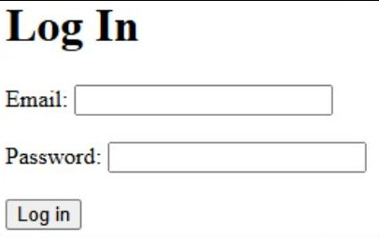
HTML Forms
TASK 2
YOUR TURN
Practice task: build a log-in form
Working on your own, create a file called login.html containing a form that:
•
sends its data to login.php using the post method
•
asks for an email address using type="email"
•
asks for a password that is hidden as dots
•
links every label to its box with for and id
•
has a button that reads Log in
Then open it in a browser and click the label text. Does the cursor jump into the box?
23

Slide 24
HTML Forms
☐ | Marking checklist
☐ | Does every input have a name? | Without it, nothing is sent.
☐ | Is there a closing </form>? | The most common missing line.
☐ | Does each for match an id exactly? | Check the spelling twice.
☐ | Is the method post, not get? | Passwords must never show in the URL.
Write your code here:
24

Slide 25
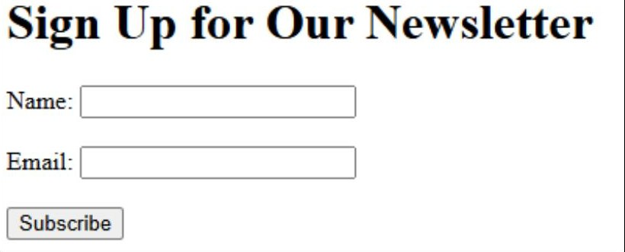
HTML Forms
TASK 3
Build a newsletter sign-up form
Working on your own, create a file called newsletter.html containing a form that:
•
sends its data to subscribe.php using the post method
•
asks for a name using type="text"
•
asks for an email address using type="email"
•
links every label to its box with for and id
•
has a button that reads Subscribe
Then open it in a browser and click each label. Does the cursor jump into the box beside it?
25

Slide 26
HTML Forms
Write your code here:
26

Slide 27
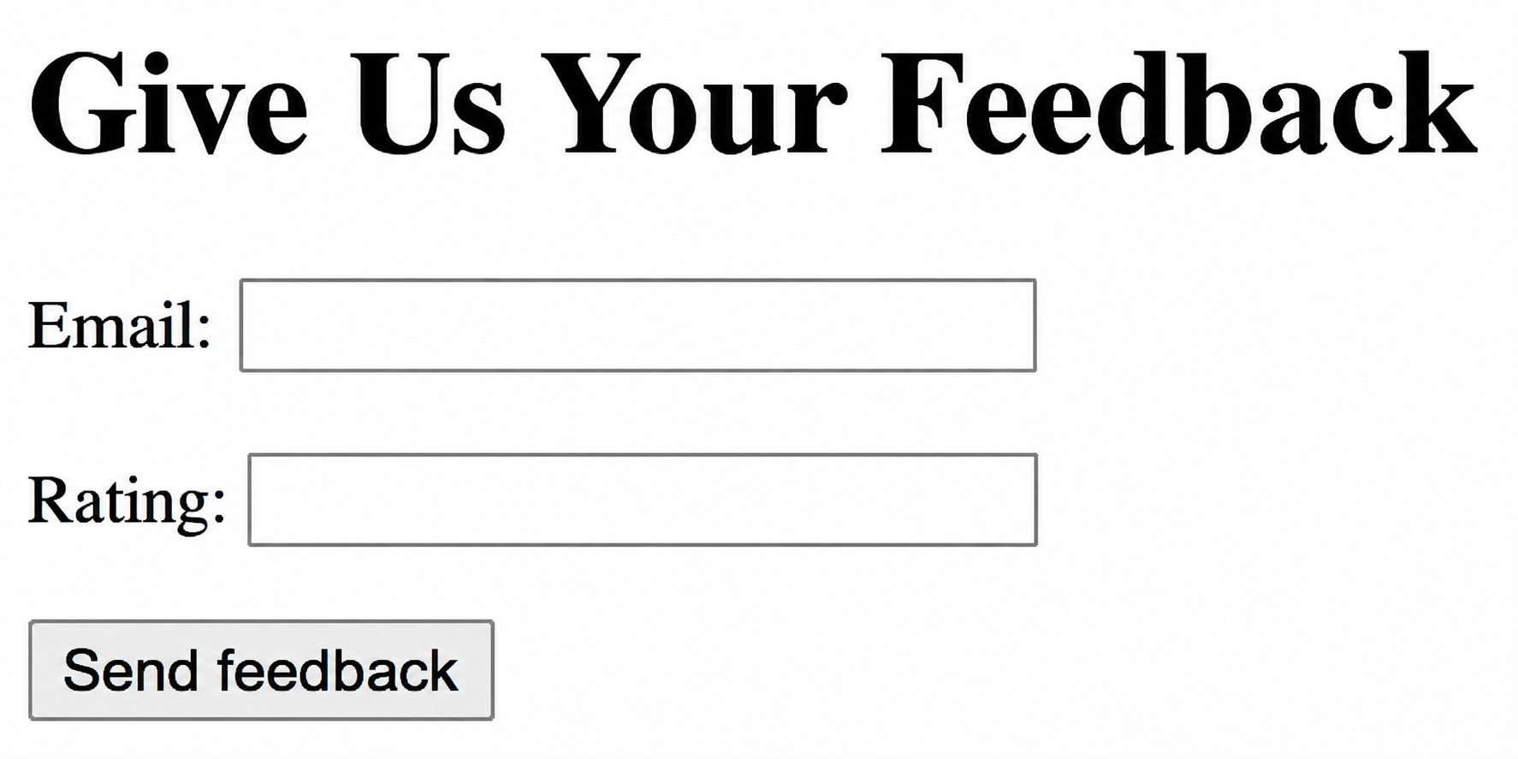
HTML Forms
TASK 4
Build a give us your feedback form
Working on your own, create a file called feedback.html containing a form that:
•
sends its data to feedback.php using the post method
•
asks for an email address type= "email"
•
asks for rating out of 10 using type=“number"
•
links every label to its box with for and id
•
has a button that reads Send feedback
Then open it in a browser and click each label. Does the cursor jump into the box beside it?
27

Slide 28
HTML Forms
Write your code here:
28

Slide 29
HTML Forms
TASK 5
Build a book search form
Working on your own, create a file called book.html containing a form that:
•
sends its data to books.php using the get method
•
Have a box labelled Title: with name=“title”
•
Have a box labelled Author: with name=“author”
•
links every label to its box with for and id
•
has a button that reads Find books
•
If a student types Things Fall Apart and Achebe, the address bar should read:
books.php?title=Things+Fall+Apart&author=Achebe
Then open it in a browser and click each label. Does the cursor jump into the box beside it?
29

Slide 30
HTML Forms
Write your code here:
30

